Slide 1
Postgraduate Certificate in Higher Education
Dr Sean Walton
s.t.walton@hud.ac.uk

Slide 2
Today’s schedule
9:30 – 10:30 Introduction to the PGCert HE
10:30 -12:30 Learning to Teach and Learning to Look
1:30 – 2:15 Questions and Answers.
2:15 – 3:15 IT Induction
3:15 Close

Slide 3
Postgraduate Certificate in Higher Education (PGCertHE)
Aims
Provide a flexible development programme in teaching and learning for staff teaching in higher education.
Enable course members to become competent and skilled practitioners in aspects of teaching, learning and assessment in higher education.
Enable staff individually and collectively to explore the conceptual foundations of new approaches to curriculum delivery and to develop and apply these approaches in their own teaching.
Enable course members to embrace professional values and attitudes to teaching, learning and assessment.

Slide 4
Aims continued
Provide a professional framework within which course members can engage in discourse with other academics, and systematically investigate issues of importance in teaching, learning and assessment in Higher Education.
Provide a framework which enables course members to reflect upon their professional experiences, and via this process, set their own targets for professional development.
Enable participants to evidence engagement with the UKPSF.

Slide 5
Learning sets
Some of the PGCertHE sessions will be in smaller, learning set groups.
You will be allocated your group over the next couple of weeks.
Learning sets will focus on using the UKPSF to structure discussions around your teaching practice and to develop ideas for the final portfolio.

Slide 6
Observations
There are a total of 4 teaching observations on the PGCertHE.
One of you observing a peer.
One of you being observed by a peer
One of you observing your academic mentor.
One of you being observed by your academic mentor.

Slide 7
Micro-teach session
As part of the course, you will deliver a 15 minute session to your learning set (with 5 mins Q&A).
This will be on 29/11/2019.

Slide 8



PGCertHE core texts

Slide 9
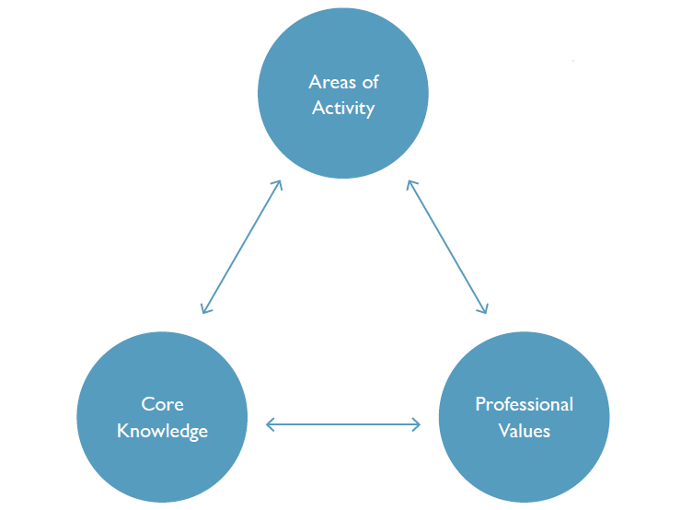
UK Professional
Standards
Framework

Slide 10
Assessment
A reflective commentary (7,000-8000 words) which is based on personal involvement with at least one University module (though evidence may be drawn from a wider context if wished). The commentary should provide an analytical and reflective account of personal development in:
teaching and learning strategies (UKPSF A1, A2, A4, A5, K1, K2, K3, K4, K5, V1, V4)
module/curriculum development (UKPSF A1, A4, A5, K1, K2, K4, K5, K6, V3, V4)
assessing student work (UKPSF A1, A3, A5, K2, K3, P3)
providing student feedback and support (UKPSF A1, A3, A5, K1, V3, V4)

Slide 11
Assessment cont
Relevant documentary evidence that demonstrates achievement of the module learning outcomes (All aspects of the UKPSF)
A record of 4 teaching observations - two as an observer, two being observed. These observations should cover a range of diverse teaching practices. (UKPSF A1, A2, A3, A4, K1, K2, K3, K4, K5, K6, V1, V2, V3)
PDP (All aspects of the UKPSF)

